Slide 1
Spring Boot Series – Day 13
Topic: Custom AuthenticationSuccessHandler & AuthenticationFailureHandler
@CodeByHaindavi | #SpringWithMe

Slide 2
Why Customize Success & Failure Handlers?
✔️ Spring Security’s default login flow returns HTML responses — which break most frontend applications consuming REST APIs.
✔️ Real products need structured JSON on both login success and failure — including user info, roles, and meaningful messages.
✔️ Frontend apps rely on clean responses to trigger dashboards, role-based access, or display login errors instantly.
✔️ Login events are critical security touchpoints — capturing them in logs adds traceability, audit value, and user activity insights.
@CodeByHaindavi | #SpringWithMe

Slide 3
When Do These Handlers Trigger?
✔️ AuthenticationSuccessHandler executes immediately after a successful login, allowing you to shape the response.
✔️ AuthenticationFailureHandler is triggered when login fails due to bad credentials, locked accounts, or other authentication errors.
✔️ These handlers are part of the authentication phase — they don’t handle access control or role-based authorization failures.
✔️ Perfect for customizing the behavior of endpoints like /auth/login in REST APIs.
@CodeByHaindavi | #SpringWithMe

Slide 4
Default vs Custom Behavior
✔️ Spring’s default flow redirects users to a login page or the root URL — which doesn’t work for API-based frontends.
✔️ Custom handlers give full control to return JSON responses — whether it’s a success token, user info, or an error message.
✔️ With structured responses, the frontend can immediately trigger dashboards, show error alerts, or update UI state.
✔️ This approach aligns your authentication flow with the rest of your API — consistent, predictable, and integration-friendly.
@CodeByHaindavi | #SpringWithMe

Slide 5
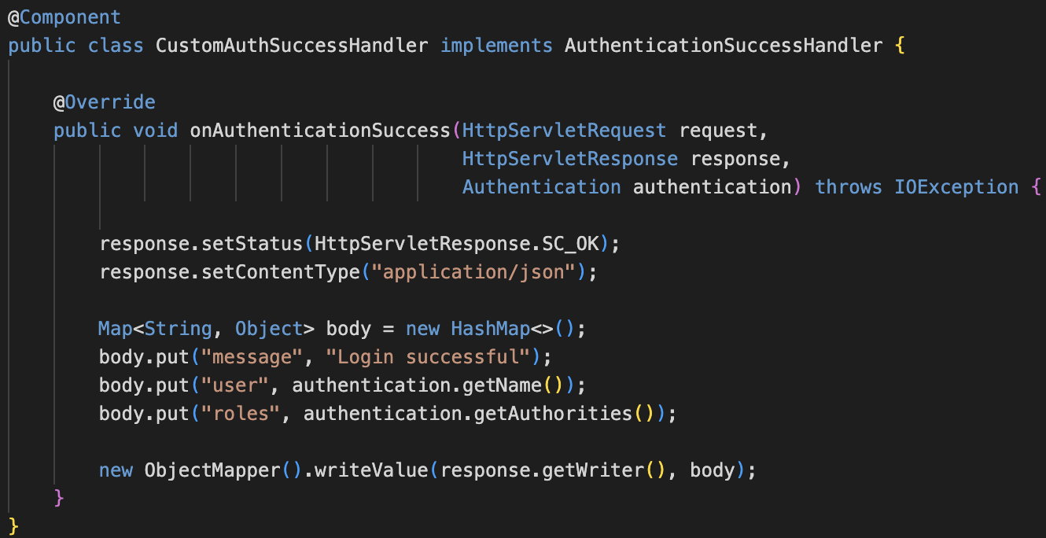
Implementing AuthenticationSuccessHandler
✔️ Create a new class and implement AuthenticationSuccessHandler to take control of what happens after a successful login.
✔️ Override the onAuthenticationSuccess() method to build your custom response.
✔️ Extract the authenticated user’s name and roles from the Authentication object and structure them into a JSON payload.
✔️ Set the HTTP status to 200 OK and return the response as application/json — ready for frontend consumption.
@CodeByHaindavi | #SpringWithMe

Slide 6
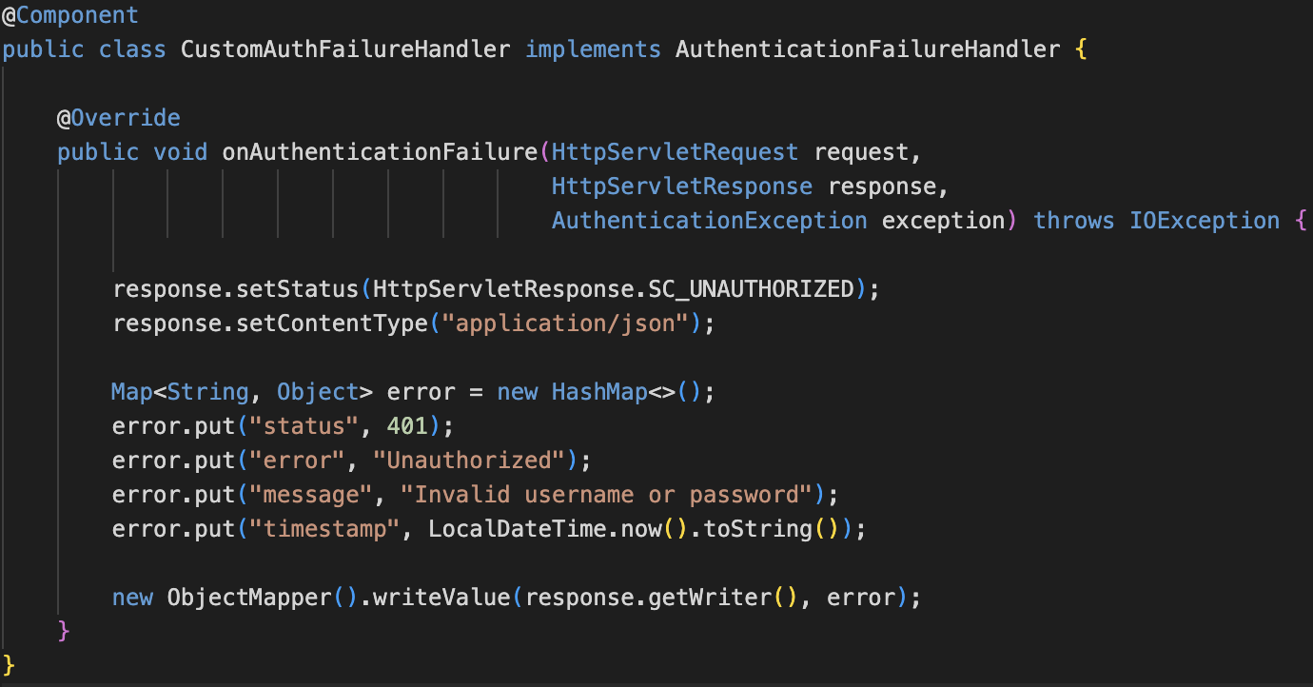
Implementing AuthenticationFailureHandler
✔️ Create a class that implements AuthenticationFailureHandler to handle login failures like bad credentials or locked accounts.
✔️ Override the onAuthenticationFailure() method to take full control over the error response.
✔️ Construct a structured JSON payload with details like status code, error message, and timestamp for clarity.
✔️ Set the response status to 401 Unauthorized and content type to application/json — so the frontend receives a clean, actionable response.
@CodeByHaindavi | #SpringWithMe

Slide 7
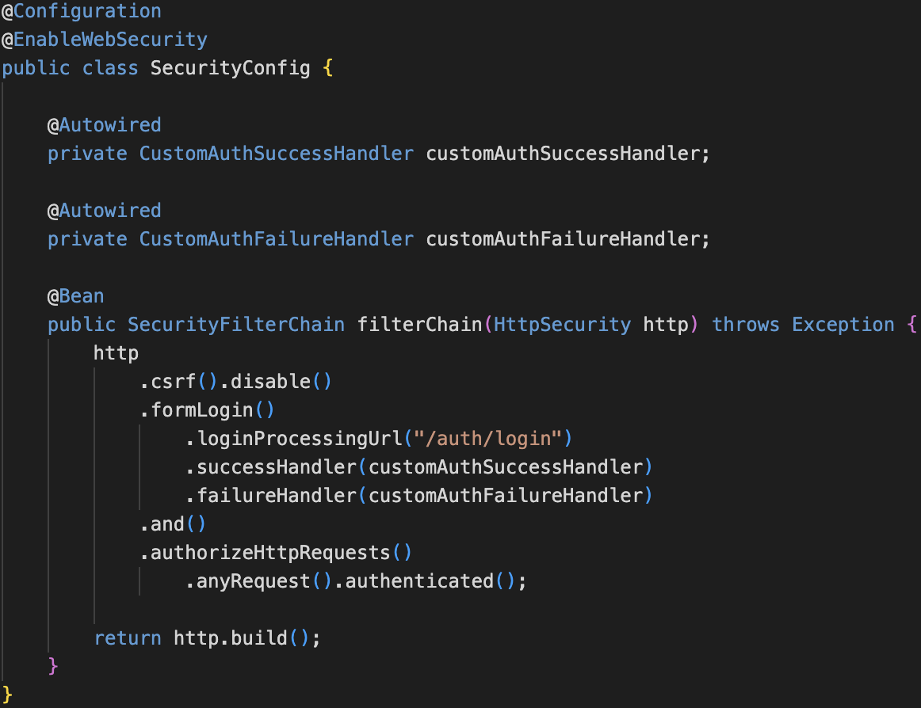
Registering in SecurityConfig
✔️ Inside the .formLogin() section of your SecurityFilterChain, plug in both the success and failure handlers.
✔️ Use .successHandler(customAuthSuccessHandler) to control what happens after a successful login.
✔️ Use .failureHandler(customAuthFailureHandler) to customize the response on failed login attempts.
✔️ This setup works seamlessly with both Spring’s default login flow and custom /auth/login endpoints in REST APIs.
@CodeByHaindavi | #SpringWithMe

Slide 8
Frontend ↔ Backend Login Flow Using Handlers
✔️ The frontend submits username and password to a secured login endpoint like /auth/login.
✔️ On successful login, the AuthenticationSuccessHandler returns a structured JSON containing the user’s name and roles.
✔️ On failure, the AuthenticationFailureHandler responds with a 401 Unauthorized status and a clear error message with timestamp.
✔️ This flow enables a smooth, frontend-driven login experience — with instant feedback and full control over navigation and messaging.
@CodeByHaindavi | #SpringWithMe

Slide 9
📌 Hands-On Tip
✔️ Always return application/json in both success and failure handlers — HTML responses break most frontend integrations.
✔️ Use a consistent JSON structure across all auth-related responses (401, 403, login errors, etc.) for easier frontend handling.
✔️ Log every login attempt — whether successful or failed — to improve traceability and detect suspicious activity.
✔️ Customize failure messages based on exception types like BadCredentialsException, DisabledException, or LockedException to give clearer feedback.
@CodeByHaindavi | #SpringWithMe

Slide 10
💼 Interview Insight
Why does Spring return HTML on login, and how do you fix it? • That happens when default behavior isn’t overridden — fix it by registering custom handlers and returning application/json explicitly
How do you ensure login attempts are traceable for audits? • Log all login attempts in both handlers with username, status, timestamp, and IP address. • Optionally persist them in a database or push to a logging system.
How would you design a login flow for web and mobile clients using Spring Security? • Use custom AuthenticationSuccessHandler and FailureHandler to return JSON instead of redirects. • Structure responses with user info, roles, and token (if needed) to support both frontend types.
@CodeByHaindavi | #SpringWithMe

Slide 11
📌 Recap – Day 13
🔐 AuthenticationSuccessHandler controls what happens after a successful login — including custom JSON, role data, or token delivery.
❌ AuthenticationFailureHandler manages all login errors, from bad credentials to locked accounts, with structured 401 responses.
📦 Both handlers return consistent, frontend-ready JSON instead of redirects — enabling a smooth login experience across platforms.
🧠 Together, they turn Spring Security’s login into a clear, controllable, and production-grade flow.
👉 Coming up next: Stateless Authentication with JWT — Eliminating Session-Based Login
@CodeByHaindavi | #SpringWithMe

